Slide 1

Medical Textual Question Answering System
Indian Institute of Technology Kharagpur
Under the supervision of:
Prof. Pawan Goyal
Mentored by:
Ankan Mullick
Presented by:
Ashish Gour
(18CS30008)

Slide 2

Introduction and Challenges
In recent years, there has been increase in the popularity of online platforms. People are using the internet for doing various daily activities. Online medical consulting is also on rise.
In rural areas, finding a doctor in an emergency consulting is next to impossible. People need to travel miles for a basic consultation.

Slide 3
Consulting a doctor online can take a long time, and solving patient queries on time is critical for several reasons.
Finding credible and reliable answers to health-related queries remains a significant challenge.
Many times patients queries are similar to previously asked ones.
Considering the criticality, answering medical queries incorrectly can sometimes result in life-threatening situations and therefore the risk should be minimized.
NLP models can be trained to provide fast and accurate solutions and reduce the burden on healthcare infrastructure.

Slide 4

Objectives
Improving the accuracy of the classification model to classify the disease class of medical queries
Retrieval of the top k significant and credible answers
Detection of entities into two categories: drugs and diseases/symptoms

Slide 5

Dataset
The data is collected from TATA’s 1mg website, which is an online healthcare platform providing services like e-pharmacy, e-consultation, and health content.
Collected a list of 2,77,646 drugs and collected a total of 5,94,324 queries.
These are real queries asked by patients and their answers by specialized doctors on the platform.
The collected data consists of many repetitions of many queries. After eliminating repeating queries, the final dataset consists of 12,125 unique queries.

Slide 6
Every row in dataset consists of the following attributes:
question: query asked by the patient
answer: answer of query by a specialized doctor
drug: link to drug’s page on 1mg website
doctor: name of the doctor who answers the query
specialty: specialization of the doctor
question | answer | drug | doctor | speciality
I am getting cough from last 4 days. Pls prescribe any antibiotic. Getting coughing regularly. | Augmentin duo 625 twice daily for 5 days | https://1mg.com/drugs/augmentin-625-duo-tablet-138629 | Dr. Pushkar Mani | Physician

Slide 7
Methodology
We defined six classes for classification models:
cold and cough
fever
vomit
acidity
diarrhea
other
These are some of the most common diseases or symptoms in India. The “other” class includes any queries regarding disease or symptoms falling outside the rest of the five classes.

Slide 8
We categorized each class further, where each category represents a different cause, symptom, or behavior of the class, The classes and categories are as follows:
Class | Categories
cold and cough | throat pain, blocked nose, runny nose, cold, cough, medication, children
fever | digestion, headache, chest burn, nausea, medication
diarrhea | typhoid, pain, chicken pox, dengue, medication, children
acidity | digestion, abdominal pain, medication, children
vomit | digestion, headache, pregnancy, medication, children
other | -

Slide 9
For getting the best results, the system first needs to
map the query to the most relevant disease class and the class’s relevant categories.
retrieve the top k answers for the new query from previously answered queries in these categories
For example, a patient’s query is “Allergic severe cough in every winter”.
It is classified into the “cold and cough” class and into “cough”, “throat pain”, and “cold” categories.
Based on already answered queries of these categories, model will retrieve the most relevant k answers.

Slide 10
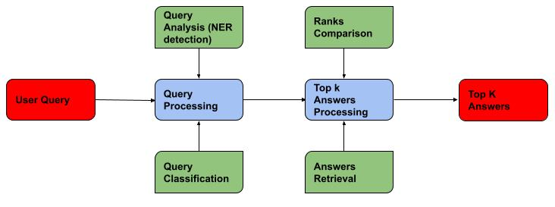
Figure below shows the general architecture of Question-Answering

Slide 11
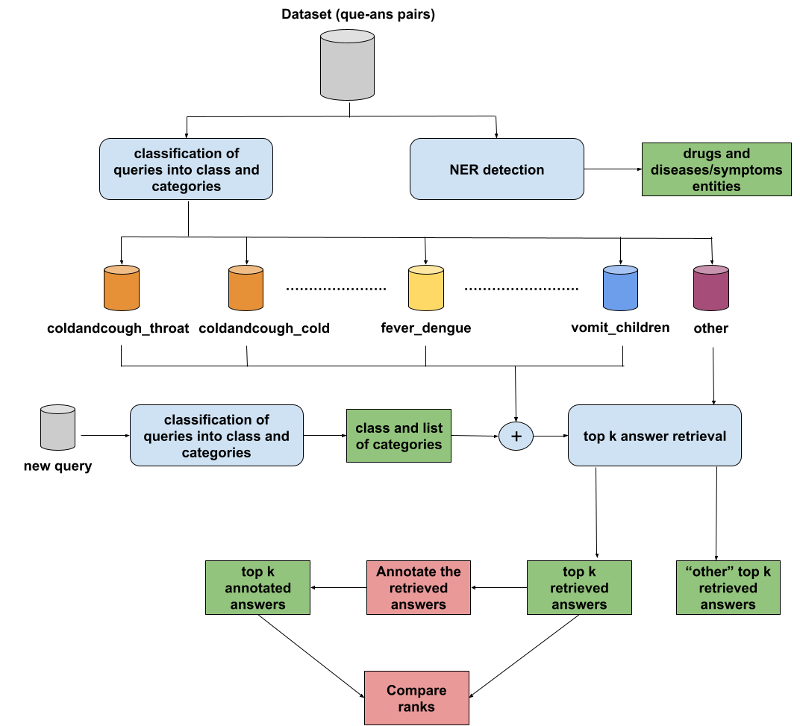
The overall proposed framework is shown in figure below.

Slide 12
We annotated the first 3000 queries into the 6 defined classes. The distribution of queries into classes for first 3000 queries are as follows:
Class | No. of queries
cold and cough | 350
fever | 88
diarrhea | 39
acidity | 45
vomit | 55
other | 2423

Slide 13
Experiments
01
Classification
Compare the macro F1 scores and accuracies of different classification models
Selected 30 queries from each class, annotate them to calculate class-wise accuracies
02
Answer retrieval
Retrieval of top k relevant answers for a new query
Comparison between Annotated rank vs Retrieved rank
Example
03
Fine-tuning
Linear fine-tuning
K-shot fine-tuning
Full fine-tuning
Evaluation of different classification models
04
NER detection
Compare the accuracies of different NER models
Example

Slide 14
Classification
We implemented and trained different models, below table shows the comparison between the macro f1-scores and accuracies of different classification models.
Model | Macro F1 score | Accuracy
Linear Regression | 0.27 | 0.86
SVM | 0.54 | 0.92
Decision Tree | 0.67 | 0.90
RoBERTa large | 0.57 | 0.82
BART large | 0.70 | 0.89

Slide 15
We apply the classification model to the rest of the queries and selected 30 queries from every five classes (except the “other” class) randomly, giving us a total of 150 queries.
We manually annotate their class to calculate the accuracy for each class, Table 4.2 below illustrates the class-wise accuracies for these 150 queries:
Class | Accuracy
cold and cough | 90.0%
fever | 90.0%
diarrhea | 66.6%
acidity | 46.6%
vomit | 90.0%

Slide 16
Answers retrieval
We used the first 1000 queries as our corpus for retrieving answers to these 150 queries, and retrieved the best k=3 answers from their respective categories.
We annotate ranks for the answers retrieved based on how significant the answer is for the query and compared them with the retrieved ranks.
We also retrieved the answers from the “other” class.

Slide 17
Out of 150 queries:
For 20 queries, the answers were unsatisfactory*
For 24 queries, the answers retrieved from the “other” class were better than the answers retrieved from its own class and categories*
For the rest of the 106 queries, the answers retrieved were significant and satisfactory
*(34 out of these 44 queries were false positives in their respective classes)

Slide 18
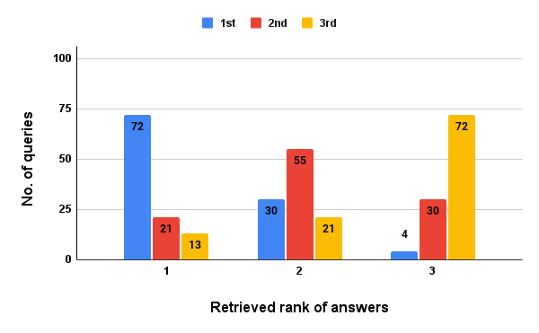
Figure below shows the comparison between the Retrieved rank(rank output from the model) vs Annotated rank(manual rank) of top k=3 answers for the 106 queries with satisfactory answers:

Slide 19
Example
Query: “Medicine for throat pain and cold”
It got classified into the “cold and cough” class and into the “medication”, “throat pain” and “cough” categories
We retrieved top k=3 answers to the query in the given categories, following are the answers we got:
Tab zerodol P / BPBetadine gargles for throat
Tab Dolo 650 mg twice daily / Alex cough syp twice daily
Take dolo 650 mg three times a day for two days, tab alaspan am once a day for five days
Annotated rank order for retrieved answers is 1-2-3, which is the same as their Retrieved ranks

Slide 20
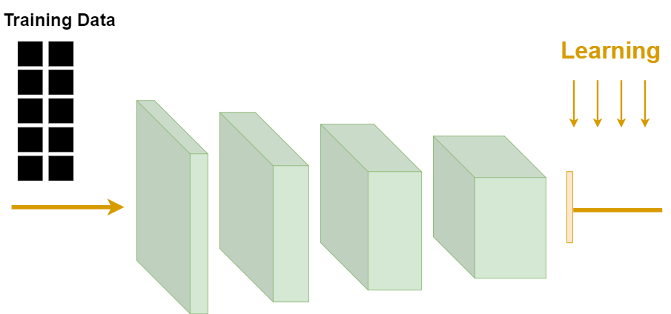
Fine-tuning
We started fine-tuning BERT model to achieve better performance.
Linear fine-tuning
Linear fine-tuning | Macro f1 score
linear layer | 0.15
last 2 transformers layers and linear layer | 0.41
last 3 transformers layers and linear layer | 0.40
last 4 transformers layers and linear layer | 0.35

Slide 21
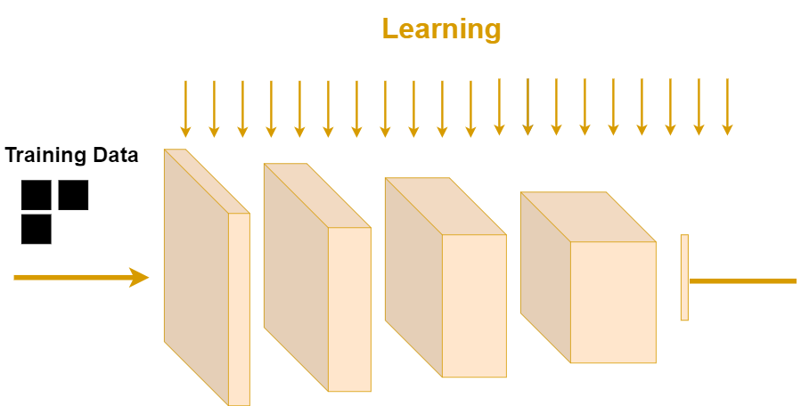
K-shot fine-tuning
Following table shows the macro F1 score for different k values and weight_decay:
k values | weight_decay=0.01 | weight_decay=0.001
k=1 | 0.06 | 0.01
k=5 | 0.12 | 0.07
k=10 | 0.15 | 0.16
k=15 | 0.29 | 0.33
k=20 | 0.37 | 0.34
k=25 | 0.33 | 0.39

Slide 22
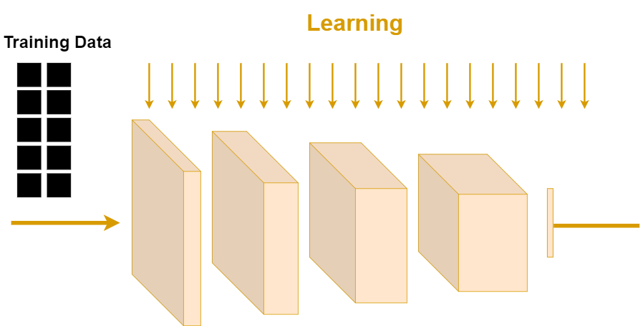
Full fine-tuning
Following table shows the macro F1 score for different learning_rate and weight_decay:
For weight_decay = 0.001 and learning rate = 1e-5 gives best performance.
Learning rate | weight_decay=0.01 | weight_decay=0.001
learning_rate = 1e-6 | 0.28 | 0.27
learning_rate = 1e-5 | 0.83 | 0.87
learning_rate = 1e-4 | 0.15 | 0.15
learning_rate = 1e-3 | 0.15 | 0.15

Slide 23
Other experiments
Adding class_weights to the BERT model:
Macro F1 score = 0.78, Accuracy = 94%
Similarly full fine-tuned BART and RoBERTa models:
BART
Macro F1 score = 0.80, Accuracy = 94%
RoBERTa
Macro F1 score = 0.77, Accuracy = 94%

Slide 24
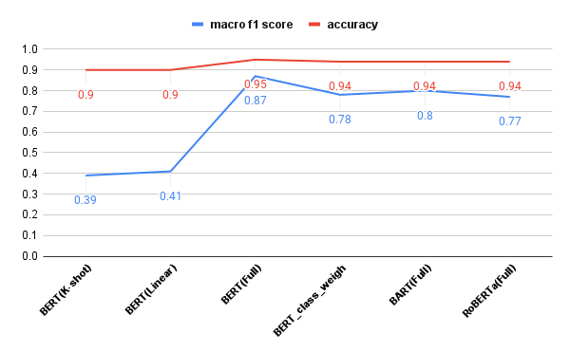
Evaluation of different classification models:

Slide 25
NER detection
We implemented two models for NER detection to detect entities into two categories: drugs and diseases/symptoms
d4data/biomedical-ner-all:
a fine-tuned DistilBERT Transformer model with change in the last layer of the model
detects entities as ‘Medication’ and ‘Sign_symptom’
en_ner_bc5cdr_md
NER model which was derived from scispaCy, trained on the BC5CDR corpus
detects entities as ‘CHEMICAL’ and ‘DISEASE’

Slide 26
We annotated first 100 queries applied both models and calculate class-wise accuracies.
Table below compares the class-wise accuracies of the NER results of the two models
Class | d4data/biomedical-ner-all | en_ner_bc5cdr_md
cold and cough | 0.43 | 0.43
fever | 0.52 | 0.52
vomit | 0.50 | 0.50
diarrhea | 0.50 | 0.25
acidity | 0.29 | 0.13
other | 0.41 | 0.53

Slide 27
Example
Query: “Can we give ambrodil-s and polymol kid for 6 months baby at a time for fever and cough?”
Table below shows the NER detection for the above query using two models.
value | d4data/biomedical-ner-all | en_ner_bc5cdr_md
ambrodil-s | Medication | -
polymol | Medication | -
fever | Sign_symptom | DISEASE
cough | Sign_symptom | DISEASE

Slide 28
Conclusion
We worked with various classification models, compare macro F1 score and accuracies.
Full fine-tuned BERT model performs best in classifying medical queries.
We are able to accomplish Macro F1 score of 0.87 with 95% accuracy.
Adding class_weights to pre-trained model results in relatively poor performance.
On basis of results, we concluded that fine-tuned BERT model works better than other models for imbalanced datasets.
Retrieved most relevant k answers to new queries. The answers were significant if the query is classified accurately.

Slide 29
Future Work
Improve the NER models to get more accurate detection of drugs and diseases/symptoms.
Evaluate model performance on other imbalanced medical datasets.

Slide 30
Thank You !

